Slide 1

Life
Together
Notes:
1

Slide 2

CLC
Members
CLC Meeting
Monday, September 9
6:30 p.m. - Parlor
Notes:
2

Slide 3


Wednesday Night Bible Study
with Pastor Joy
7 PM
Parlor
Wednesday Night Bible Study
with Pastor Joy
7 PM
Parlor

Slide 4

3rd Sunday
September 15 - After Worship
Notes:
4

Slide 5


September 22
Sunday
FBCL Mission Team Presents :
Guest Speaker – Beth Graverholt
Executive Director & Lead Organizer

Slide 6



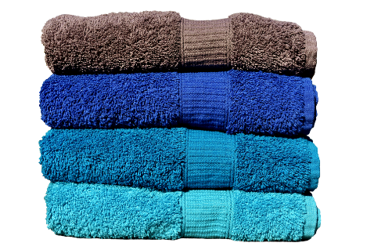
NOTE TIME CHANGE!
Women’s Ministry
Tuesday, September 24
6:00 PM in Fellowship Hall
We’ll be organizing
the books for
the Little Library!
During September & October
We’ll be collecting
New Bath Towels
& Wash Cloths
New Kitchen Towels
& Dish Rags
for the
Friendship Home!
No Meeting in July

Slide 7

No Meeting in July

Slide 8
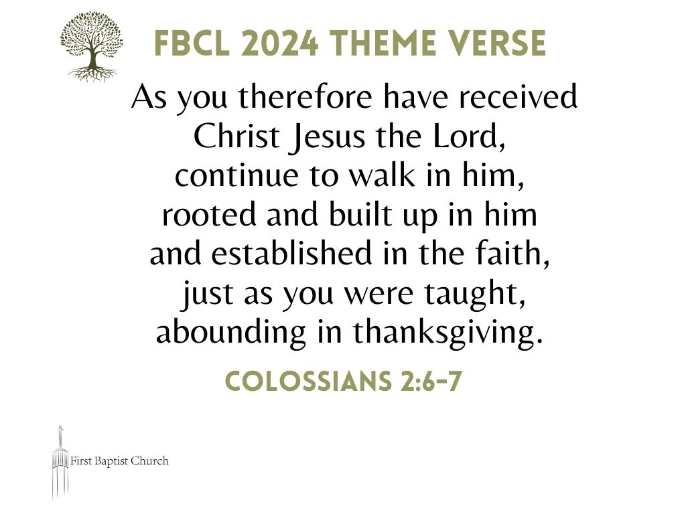

Slide 9

WELCOME –
We’re so glad you’re here!

